Slide 1

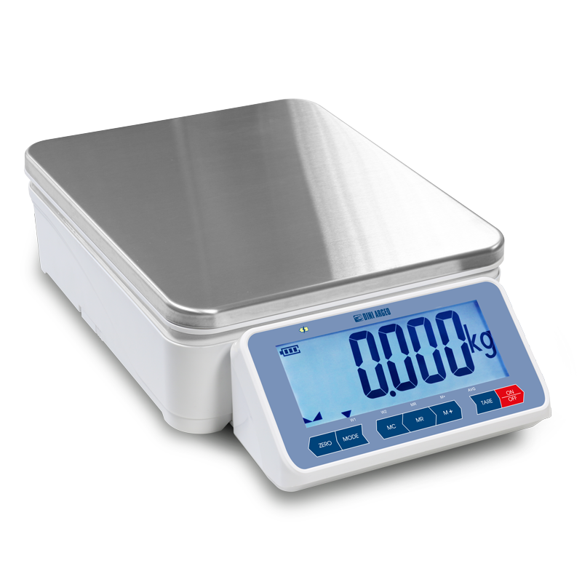

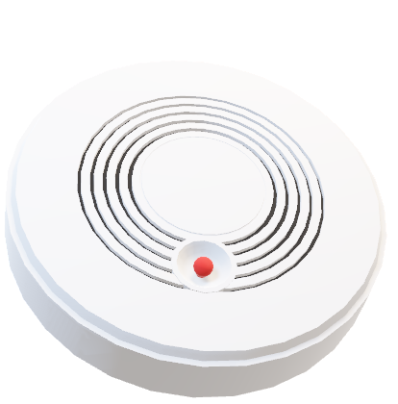
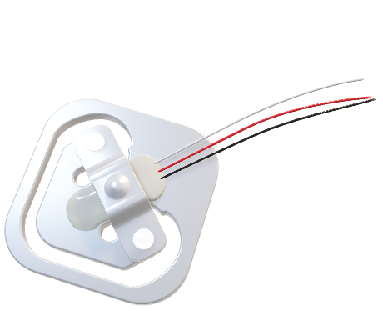
Load Cell and Fire Sensors
A visual representation of Polarization in daily important devices

Slide 2


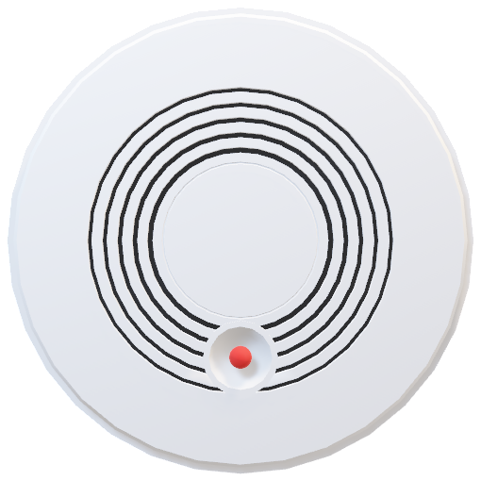

Piezo-electricity and Pyro-electricity
Piezo is a Greek word for Pressure. Thus, Piezoelectricity refers to the electric response under a pressure or a “Load”
Pyro is a Greek word for Fire/Heat. Thus, Pyroelectricity refers to the electric response under the influence of heat.

Slide 3
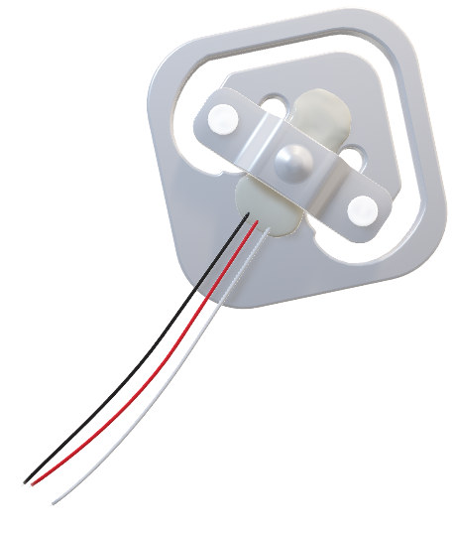
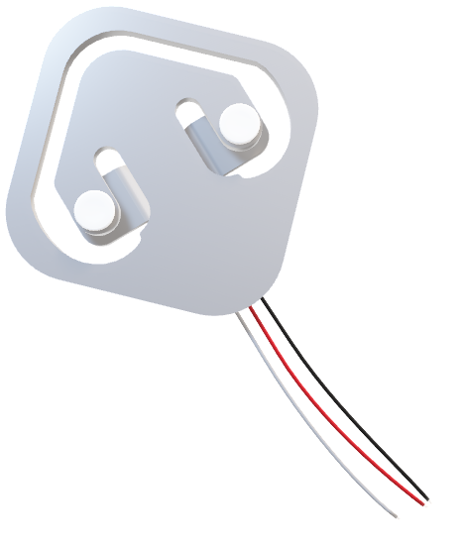
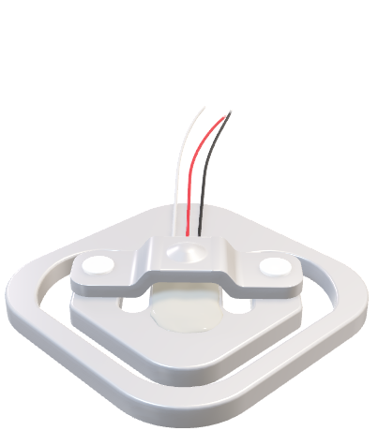
LOAD CELL
Load application point
Mounted Assembly
Spring Element

Slide 4

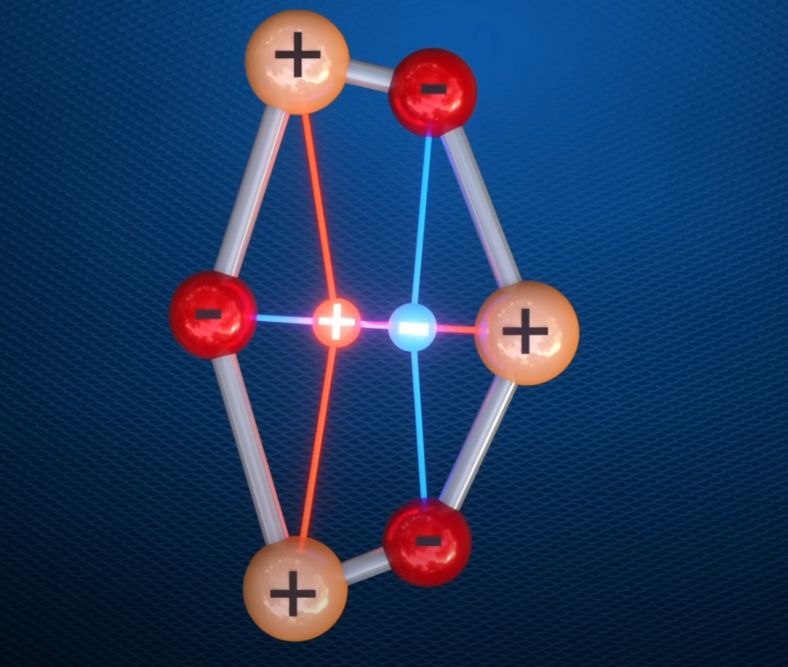
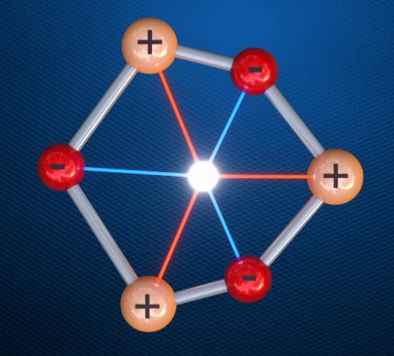
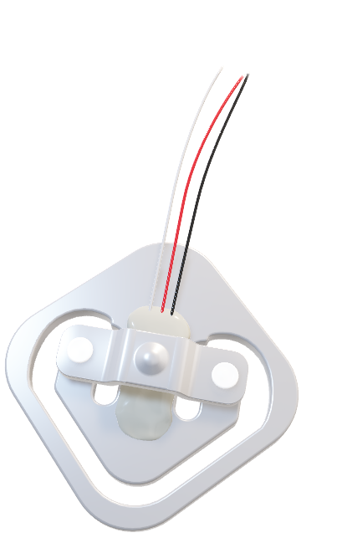

Slide 6
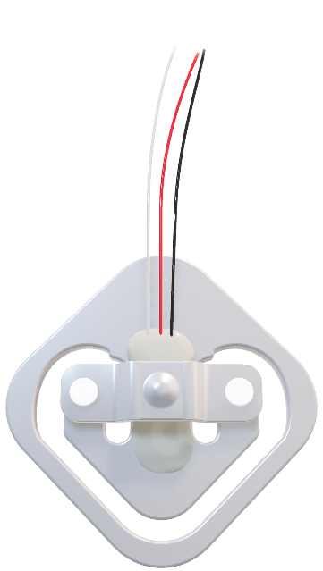
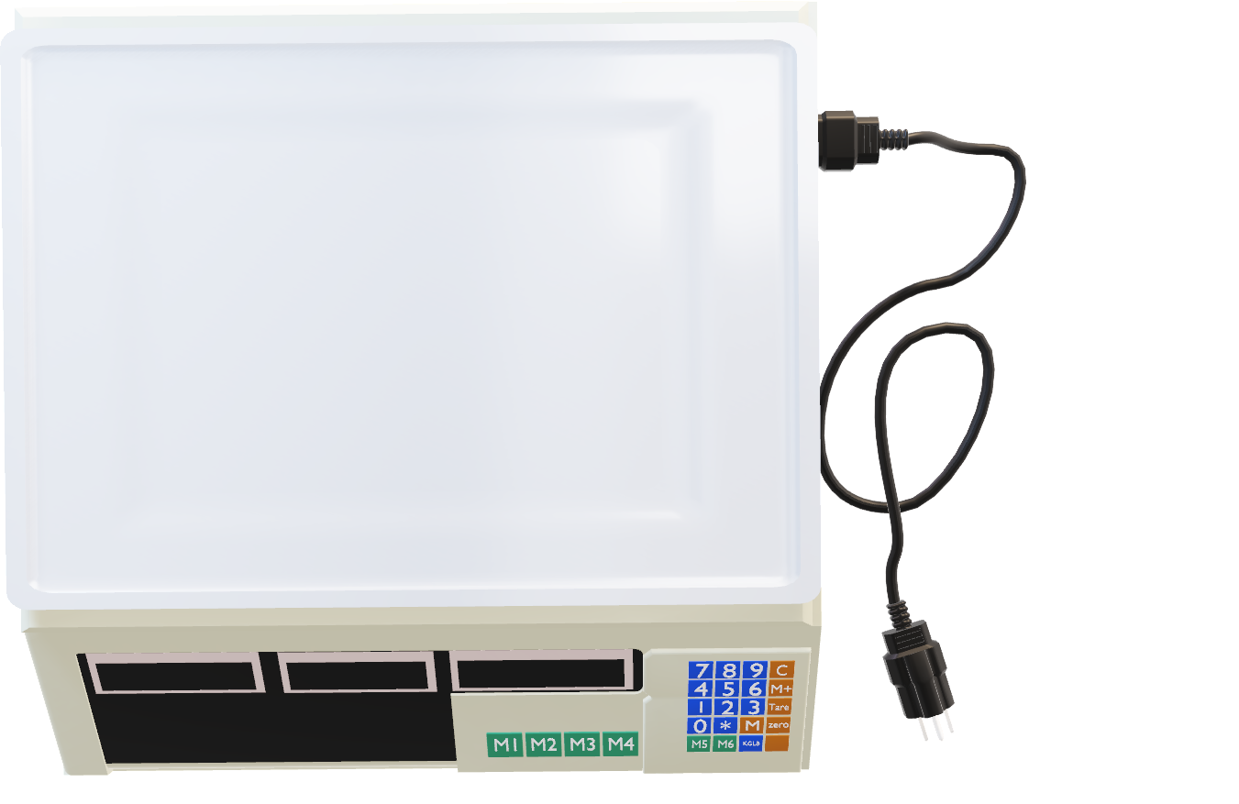

Slide 7
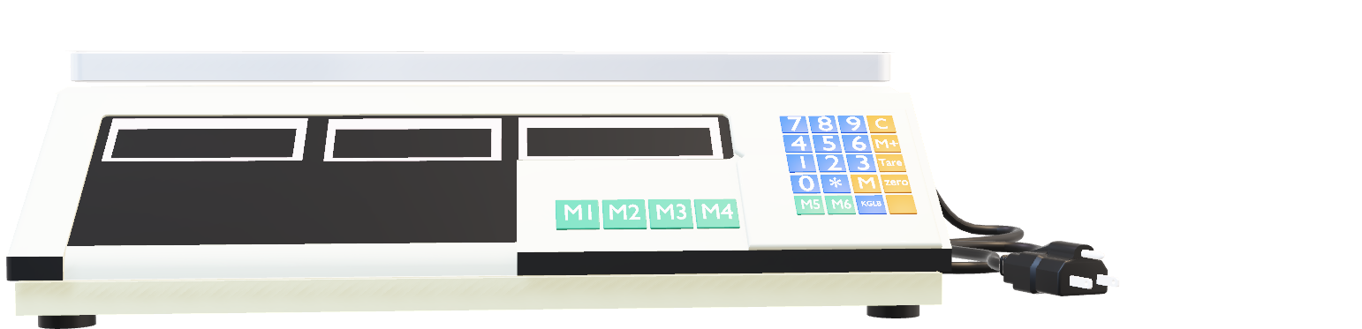

Slide 8

Piezo-electricity and Pyro-electricity
Piezo is a Greek word for Pressure. Thus, Piezoelectricity refers to the electric response under a pressure or a “Load”
Pyro is a Greek word for Fire/Heat. Thus, Pyroelectricity refers to the electric response under the influence of heat.

Slide 9
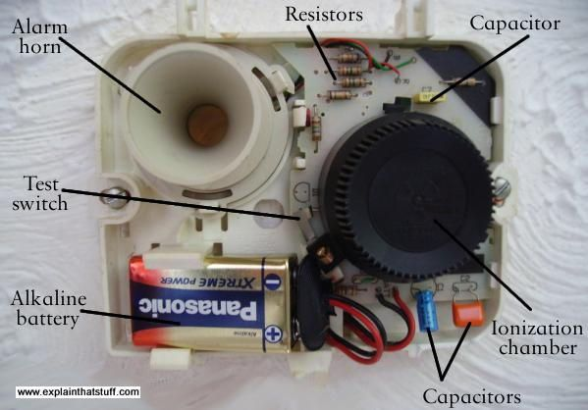

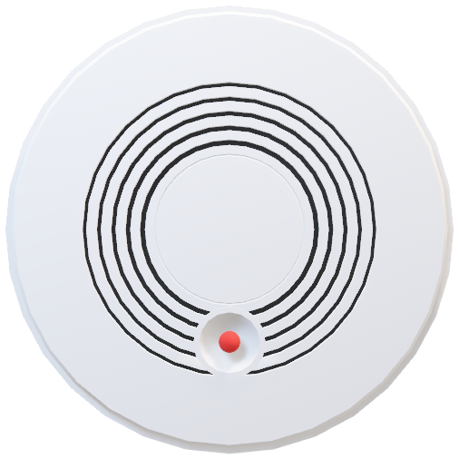
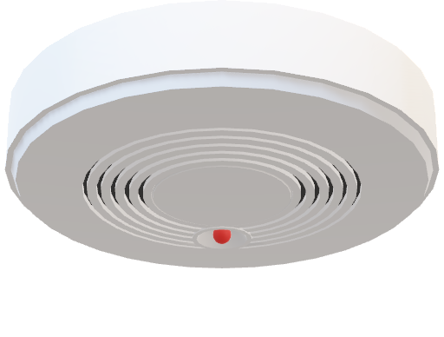
FIRE DETECTOR
Smoke Vent
Battery, Details etc.
Alarm

Slide 11

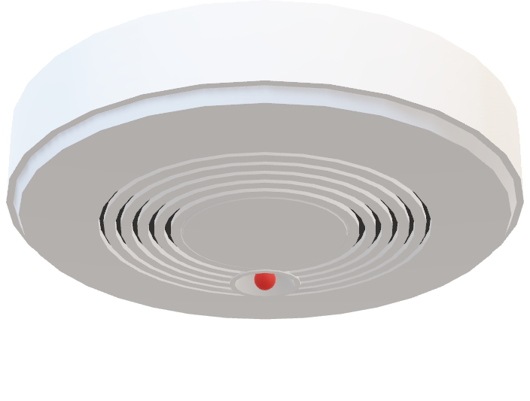

Slide 12
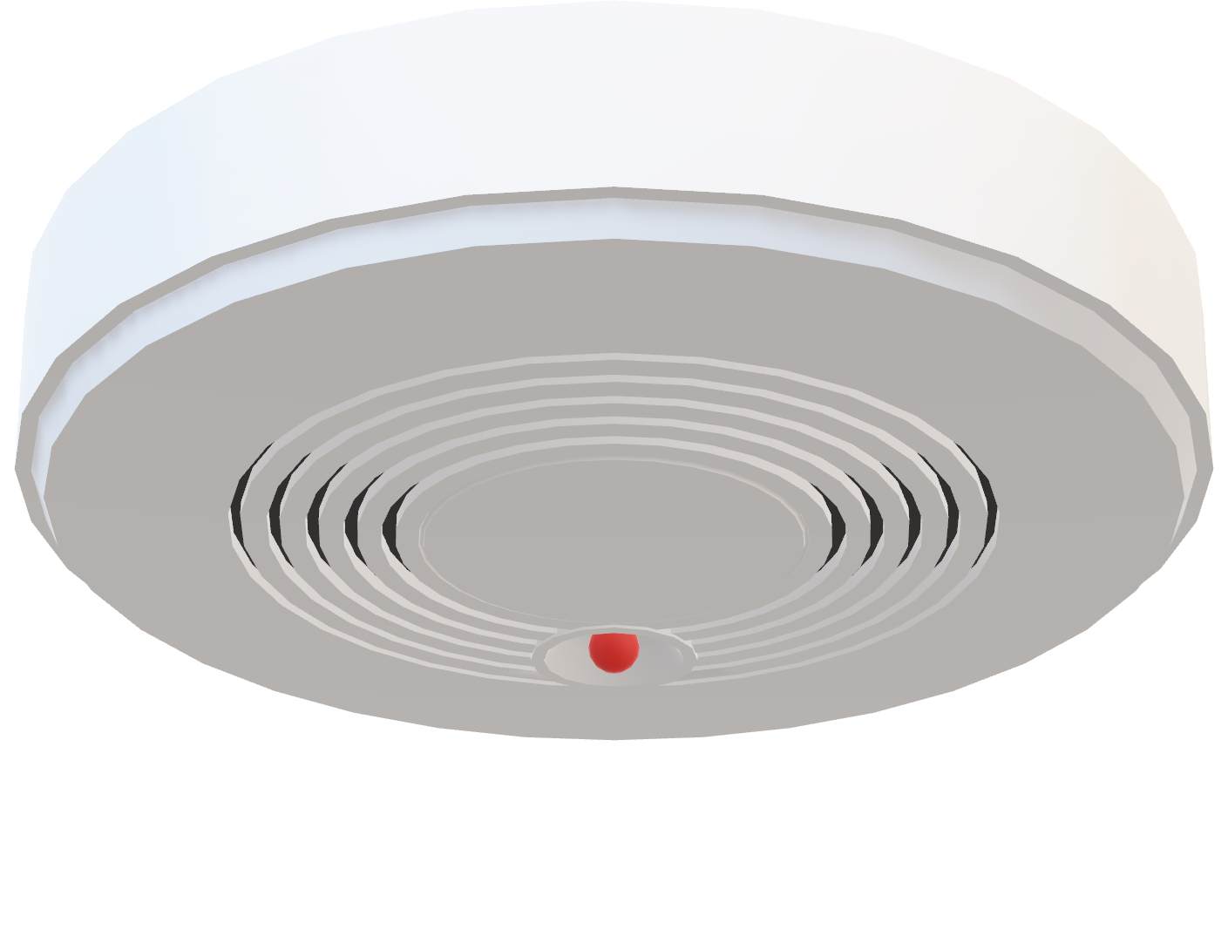

Slide 13

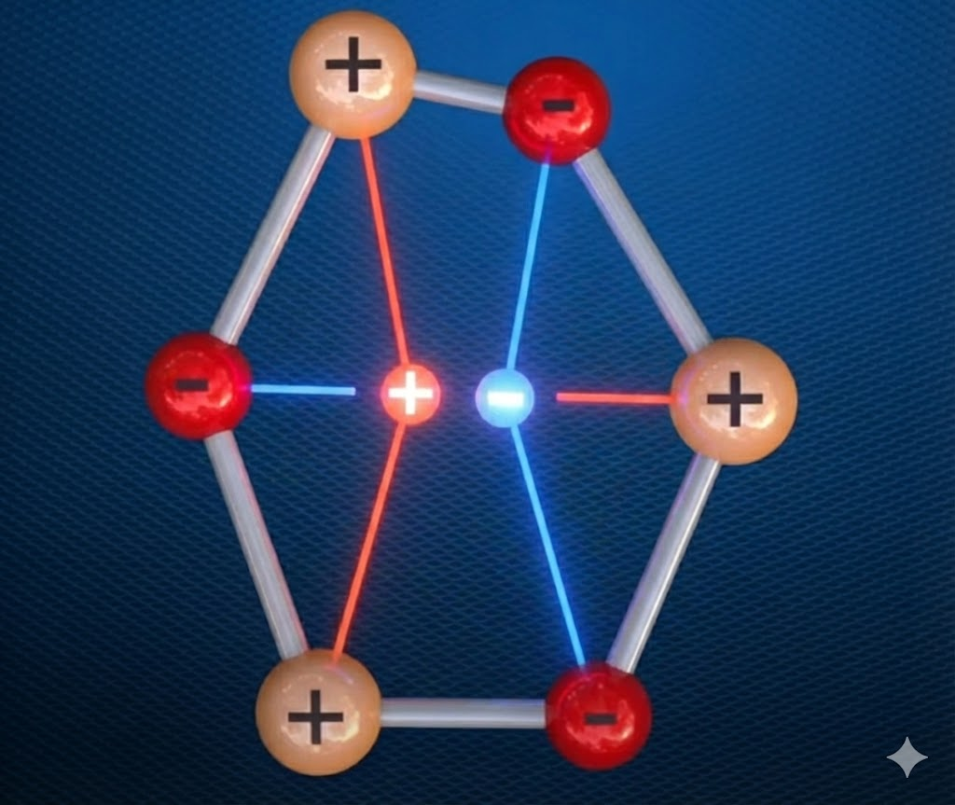
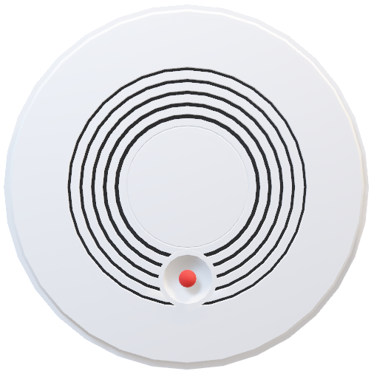

Slide 15


THANK YOU

Slide 16
